Slide 1

How To Get The Most Out of Your Upgrade

Slide 2
Synopsis
We’ll discuss strategic differentiators available so you can get the most for the business out of your upgrade. We’ll discuss where to focus your efforts for business processes, reporting, data management, integrations. We’ll also talk about managing people and training for those that may be displaced.
PowerPoint available for download at https://github.com/NathanClouseAX/CommunityPresentations/tree/master/2021

Slide 3
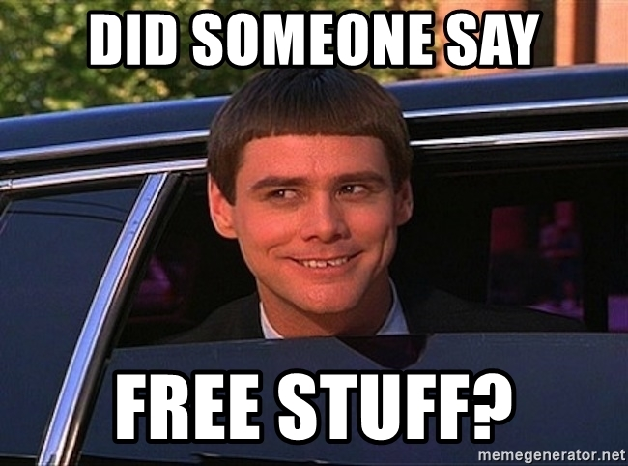
Free Stuff
Gift Card Give Away!

Slide 4

Kelly Gustafson
Sr. Functional Consultant/Engagement Manager at Alpha Variance Solutions
Microsoft MVP/MCT
Kgustafson@alphavsolutions.com
www.d365fandom.com
@KellyLappG

Slide 5

Nathan Clouse
Technical Architect enVista Corp.
Microsoft Business Applications MVP
nclouse@envistacorp.com
www.atomicax.com
@NathanClouseAX

Slide 6

Upgrades – Why do I need this?
Your system is nearing the end of Microsoft support!
AX 2009
AX 2012
Mainstream support ended October 9, 2018
Extended support ends – April 12, 2022
AX 2012 RTM & R2 – Mainstream support ended Oct 9, 2018
AX 2012 RTM & R2 – Extended support ends April 12, 2022
AX 2012 R3 – Mainstream support ends October 12, 2021 (2 DAYS AGO)
AX 2012 R3 – Extended support ends January 10, 2023
End of mainstream support for Microsoft Dynamics AX 2009, Dynamics AX 2012, and Dynamics AX 2012 R2 - Finance & Operations | Dynamics 365 | Microsoft Docs

Slide 7

Business Processes
NOW is the time to consider:
WHY
Why do we do it this way?
Could there be a better way?
HOW
What is our process today?
Could we streamline our process?
WHO
Define who does what
Be clear in expectations

Slide 8

Reporting
Power BI
BYOD – Bring your own database
Data Lake
Build your own Power BI reports
Build whatever you want from external sources

Slide 9

Data Management
Replacement for DIXF
"first class citizen" now
Full featured and enterprise ready
Import and Export
UI, APIs, OData
Manage and own your data

Slide 10
Integrations
Cloud First Technologies
OData
Dual-Write / Dataverse
Batch Data API
Power Platform
Bring Your Own Database (BYOD)
Azure Data Lake
All of the Azure Platform Tools

Slide 11

Managing People
Managing people doesn't have to be a maze or a trap!
Manage expectations
Give them the resources they need

Slide 12

Training
OOTB tools
Partners
Train-the-trainer
Microsoft Learn

Slide 13
THANK YOU!

Slide 14
Final Wisdom
If you deliver too early, you'll find yourself constantly running behind

Slide 15
Questions?

Slide 16
Dynamics 365: Let’s talk Upgrade Rollout Approach (AX 2012 Upgrade Series: Part 6) – Tuesday @ 2:00
Dynamics 365 F&O Licensing, Upgrades, Costs and More (Part 2) – Tuesday @ 3:00
Retail and Warehousing: The Biggest Areas for Change in Dynamics 365 F&O (AX 2012 Upgrade Series: Part 3) – Wednesday @ 9:30
AX Sucks. Let’s talk Upgrades (AX 2012 Upgrade Series: Part 1)– Wednesday @ 10:30
An AX2012 Upgrade Journey - Wednesday @ 11:30
Dynamics 365 F&O Business Events From End to Start to End – Wednesday @ 1:40
Dynamics 365 F&O Upgrade Tech Talk: Code, Customizations, Extension and Power Platform (AX 2012 Upgrade Series: Part 5) – Thursday @ 10:00
How To Get The Most Out of Your Upgrade (AX 2012 Upgrade Series: Part 2) – Thursday @ 1:10

Slide 17
My Other Presentations
Dynamics 365 F&O Business Events From End to Start to End – Wednesday @ 1:40
Dynamics 365 F&O OData From Zero To Hero – Thursday @ 9:00
F&O Integration Roundup - Thursday @ 11:00
X++ Development Tips and Tricks plus D365FO.Tools! – Thursday @ 2:10

Slide 18
Give Away!

Slide 19




About AVS
Founded 2015 | New York
Woman-Owned Business
Microsoft Gold Partner |
Direct CSP
New York |Düsseldorf |Bangalore
Booth #756

Slide 20

Please visit our booth
enVista booth #700
Meet with our experts
Learn about industry-leading practices
Get the most from your Microsoft investments
Register to win a YETI™ cooler
enVista
Booth
Hall C Entry

Slide 21

Survey Code

